Slide 1


Handwritten Character Recognition
A Deep Learning Model by:
John Fortucci
Yann Muszynski
Alejandra Lee

Slide 2
Overview of our Project
Why image recognition?
The source data
Questions to answer
Data exploration & analysis

Slide 3
Why Image Recognition?
We decided to create a Handwritten Character Recognition application as it involves challenging ourselves to apply our knowledge of deep learning, JavaScript, HTML, and CSS. Additionally, image recognition technology is increasingly relevant in today's environment.
It's relevant
Image recognition technology has many applications, including labeling content of images with meta-tags, guiding autonomous robots or self-driving cars, and performing image content search.
It involves deep learning
To create an image recognition application, a Convolutional Neural Network (CNN) model, supported by tensorflow and keras, is typically used to recognize characters.

Slide 4
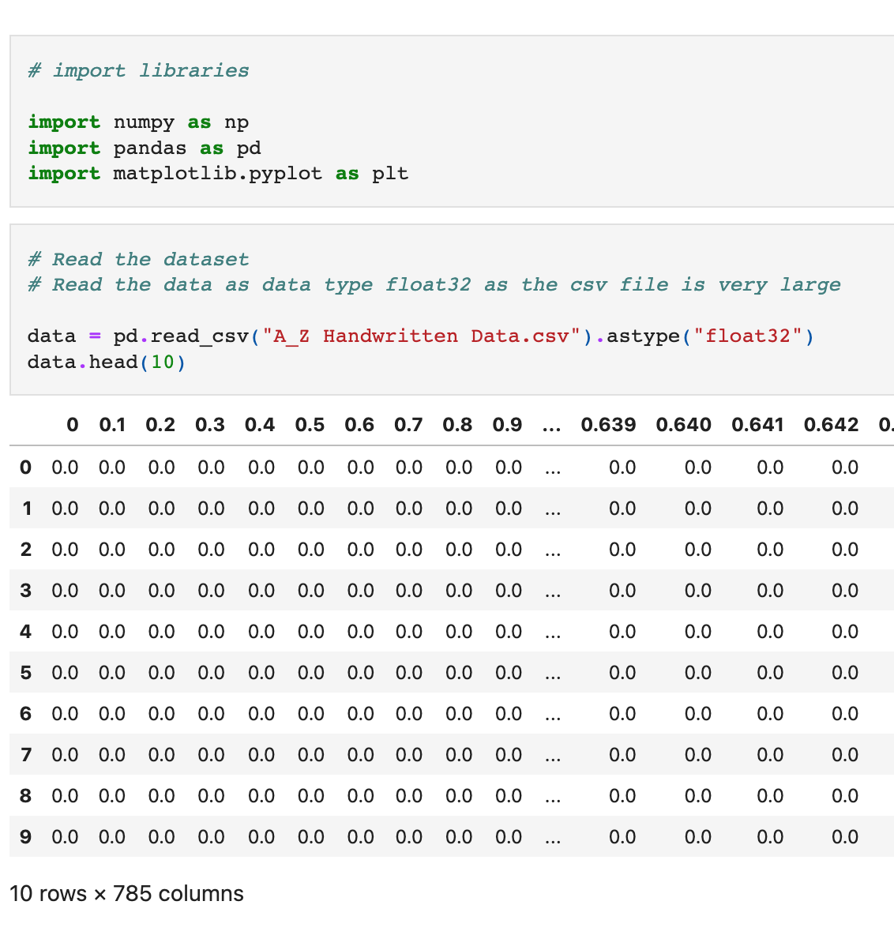
The Source Data
The dataset was obtained from kaggle.
It contains 26 folders (A-Z) containing handwritten images in size 28x28 pixels, each alphabet in the image is centre fitted to 20x20 pixel box.
Each image is stored as Gray-level.

Slide 5
Questions to Answer
?
Can our model accurately recognize handwritten characters?
?
?

Slide 6
Data Exploration & Analysis
We looked for datasets containing pixel data for handwritten characters to train the model.
Handwritten characters searched were color black with white background.
From our research, we understood that we would need a significant amount of images to create a model with a high level of accuracy.

Slide 7
The Machine Learning Model
Preliminary data
Feature engineering, selection, and decision making process
Splitting the data into training and testing sets
Explaining the model choice
Limitations & benefits of the model

Slide 8
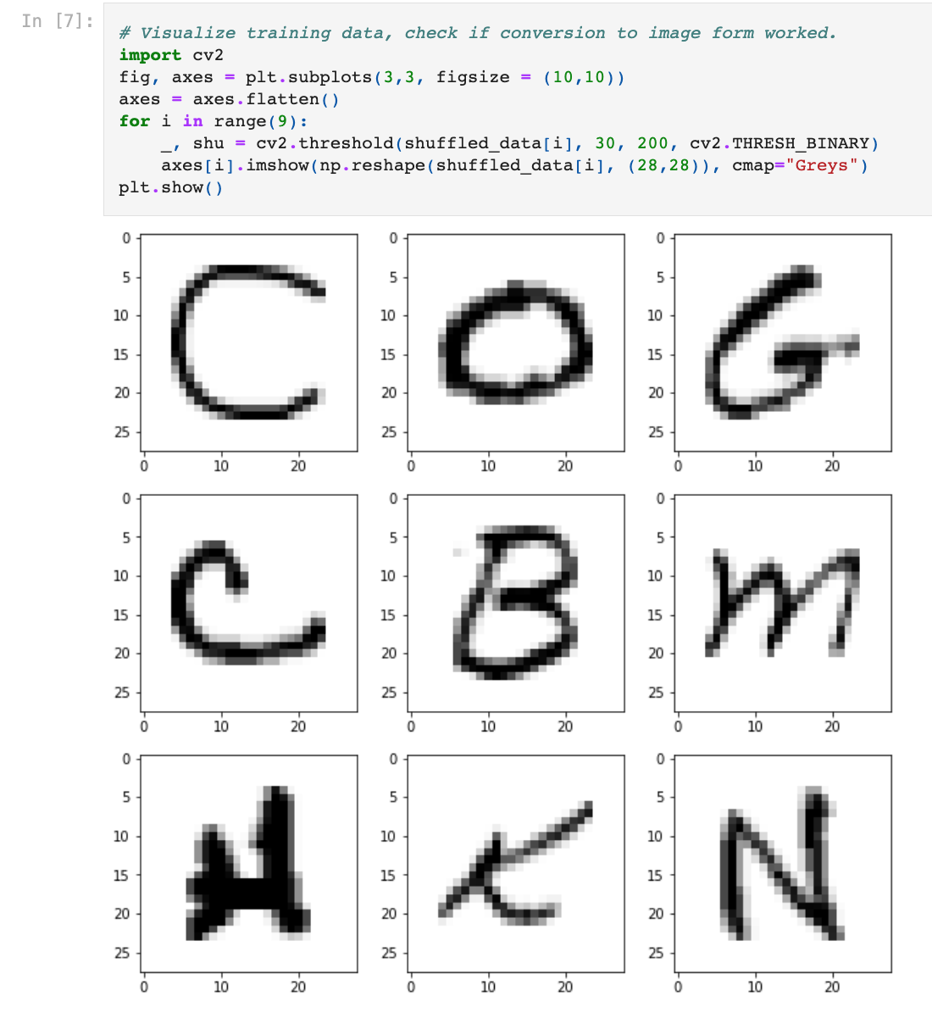
Preliminary Data Preprocessing
In the csv file, images are present in 784 columns of pixel data.
We can reshape the image data to 28 x 28 pixels using numpy to display in the form of an image.
Once an image is reshaped, we can display it in a window using cv2.imshow()
We can also use matplotlib to display the image in jupyter notebook.

Slide 9
Preliminary Feature Engineering
Feature Selection
Decision Making Process
The goal of our model is to recognize handwritten characters.
The dataset used to train the model is a collection of images displaying handwritten characters.
As such, we didn’t really have to select “features” or “columns” from the dataset to train the model (as we would if we were predicting for instance house prices and our dataset contained various variables that could potentially predict house prices).

Slide 10
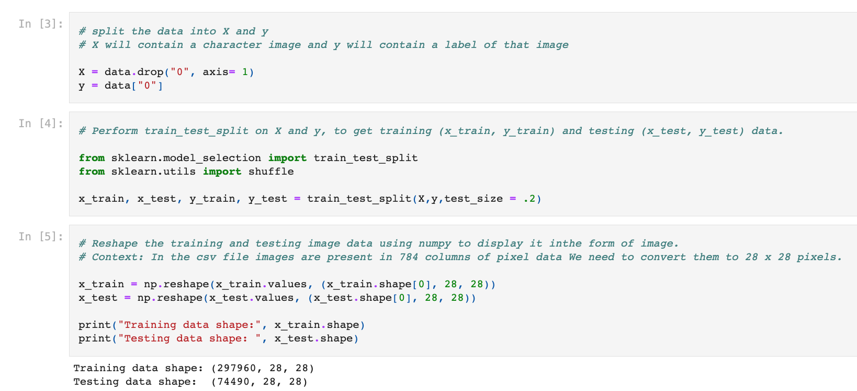
Splitting the Data

Slide 11

Convolutional Neural Networks Model
Background Considerations
At its core, an image is a 2D array of pixels. Therefore, any image should be able to be classified based on its features (pixels).
Why did we select a CNN model?
Convolutional Neural Network models are specifically designed for processing image data (pixels). They are widely used for image processing and recognition.
What is a CNN?
CNN is a combination of Convolutional Layers and Neural Network. It consists of:
An Input Layer
Convolutional Layers
Pooling Layers
Dense Layers

Slide 12
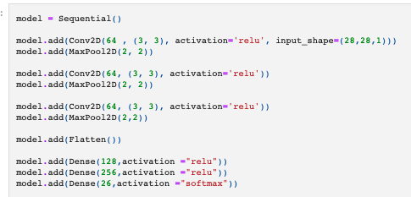
How does our CNN model work?
Step 1: Feed the input layer of the neural network an array with pixels of the handwritten character
Step 2: Use convolutional layers to extract image features and return them in the form of a matrix
A ReLu activation function is applicad after every convolution to transform the output values between the range 0 and 1.
Step 3: Use a Pooling Layer to reduce the size of the matrix
This helps the model to deal with overfitting by providing an abstract representation and also reduces the computational cost.
Step 4: Flatten the data to convert a 2D matrix into a vector
After the convolution and pooling layers, the data is flattened into a feedforward neural network which is also called a Multi-Layer Perceptron.
Step 5: Feed the flattened data into the Dense Layer to classify the image based on the output from the convolutional layers
A dense layer is a neural network layer that receives input from all neurons of its previous layer. Our model uses the relu activation function for 2 dense layers and softmax activation function for the output layer.

Slide 13
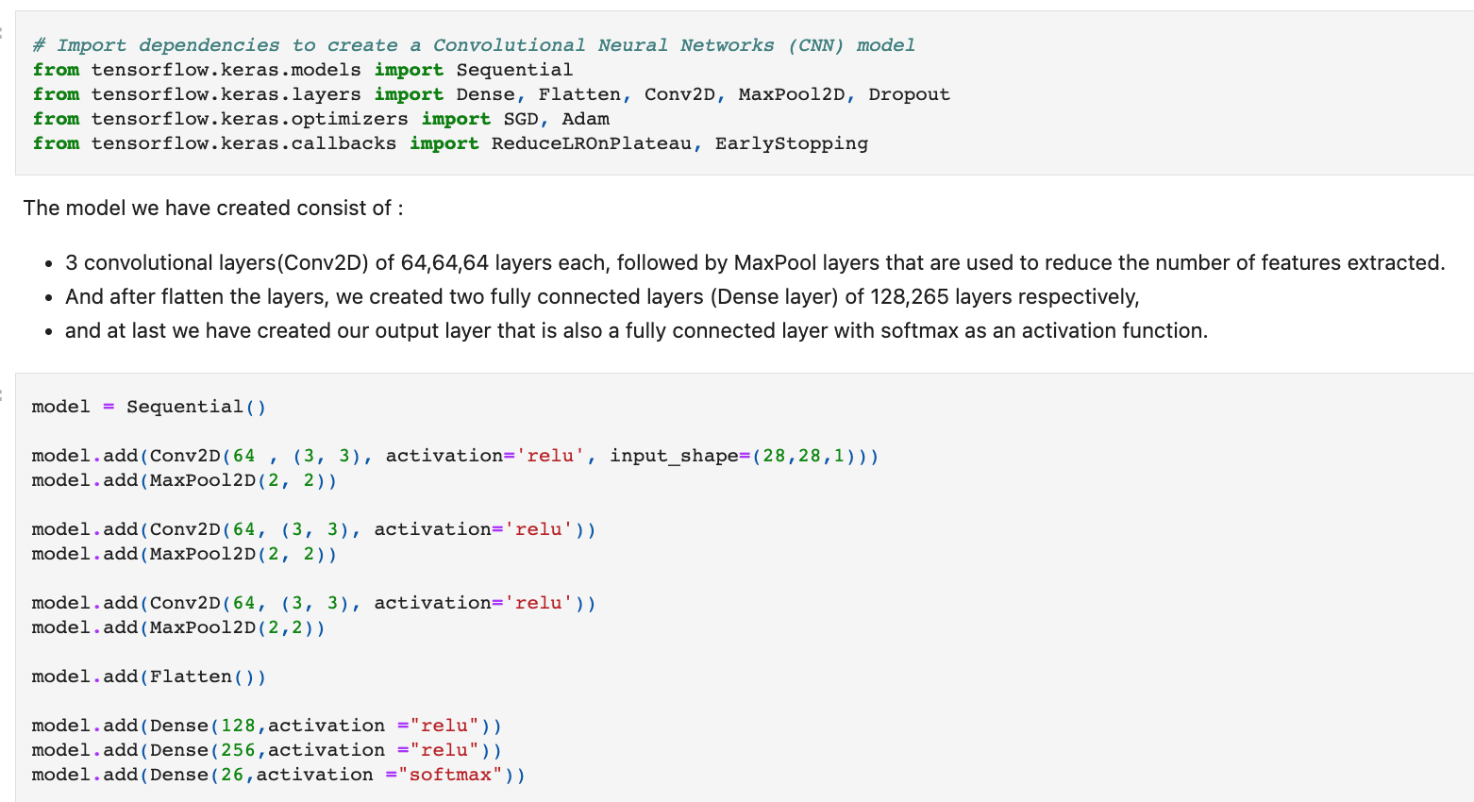
The Model Choice

Slide 14
Limitations and Benefits of the Model
Limitations
Hard to classify images with different positions
Hard to classify images with different backgrounds or under different lighting conditions
CNN is slow
A large dataset is needed to train the neural network
Advantages
Automatically detects the important features without any human supervision
Fast to implement and relatively easy to understand

Slide 15
Dashboard
Tools used to create the dashboard
Interactive elements
Our final dashboard

Slide 16


Tools to Create the Dashboard
HTML, CSS and Javascript - Used to build a simple user friendly website with a login function for the user.
Canvas API - provides a means for drawing graphics via JavaScript and the HTML <canvas> element.
Free Bootstrap Template - Free to use bootstrap template for styling.

Slide 17
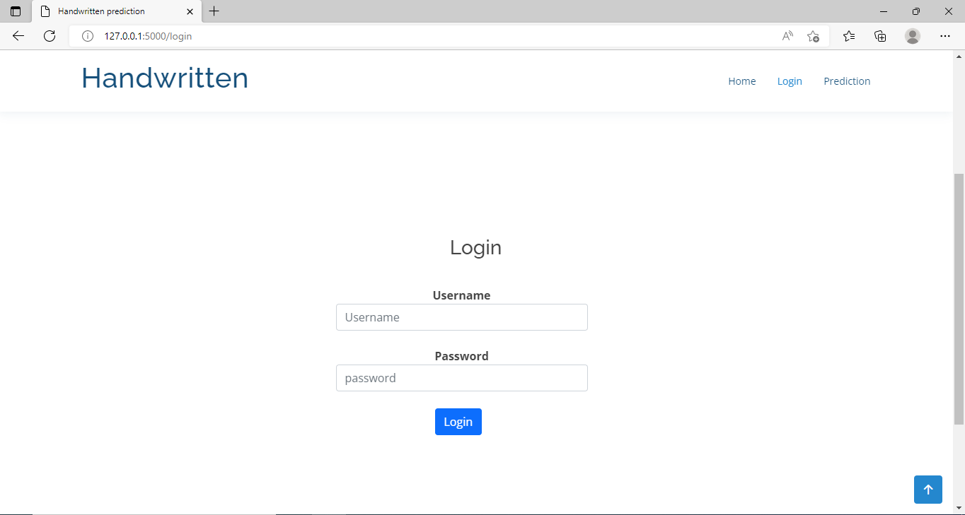
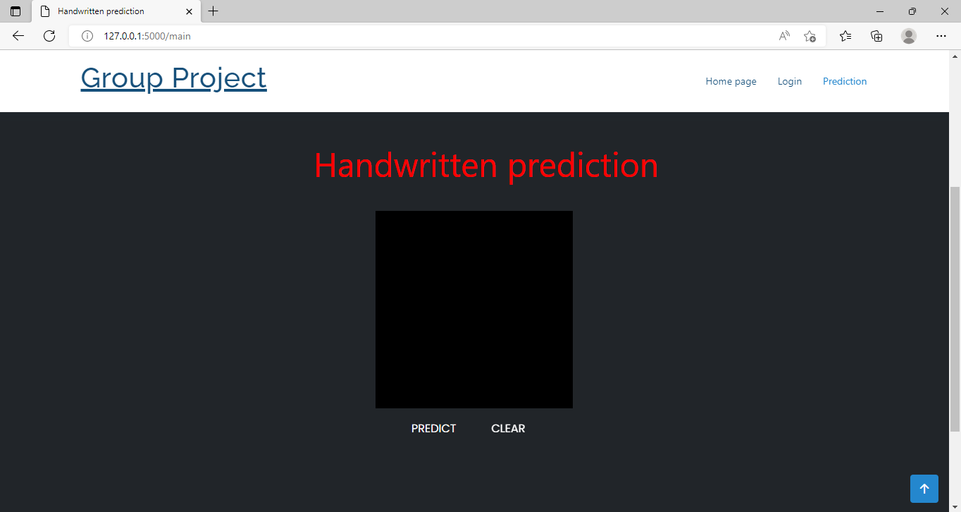

Slide 18
Bibliography
Introduction to Convolutional Neural Network (CNN) using Tensorflow | by Govinda Dumane | Towards Data Science
Neural Network Definition
Image Classification using Convolutional Neural Network with Python

